Slide 1
DESIGN AND IMPLEMENTATION OF A HOSTEL BOOKING SYSTEM : NILE UNIVERSITY OF NIGERIA
NAME: CHIBUEZE KINGSLEY ONYEKPERE
STUDENT ID: 201212021
SUPERVISOR: MOHAMMED ALIYU SULEIMAN

Slide 2
INTRODUCTION
The implementation of a digital Hostel Reservation System (HRS) appears as a promising approach to address these challenges and improve the accuracy and efficiency of the hostel reservation process at Nile University of Nigeria. The Hostel Reservation System transforms how hostel reservation is carried out, by utilizing cutting-edge algorithms and computing power. By automating the process, the HRS makes sure that hostels are assigned efficiently while sticking to the established constraints and considerations at the school. The assignment process is greatly simplified by this automation, which also lessens the need for extensive manual modifications.
This Hostel Reservation System (HRS) at Nile University in Nigeria has the potential to completely alter the way that hostel reservations are made, resolving many of the issues with the current system. The HRS equips the school to assign rooms to students in an efficient, effective, and constraint-compliant by utilizing the power of algorithms and computational intelligence.

Slide 3
PROBLEM STATEMENT
The school's current system for hostel reservation has serious problems. Students are assigned rooms manually and at random. This ultimately reduces familiarity with roommates and increases the potential for conflicts. The process is not transparent as students who apply for hostel do not know the exact room they are going to lodge in until they come to the hostel reception. Ultimately a student could get frustrated or misdirected when trying to find a suitable room where they could lodge in.
For the refectory system the use of tickets is paper-intensive which is not sustainable and harmful to his environment. Additionally, the system is vulnerable to unnoticed constraint violations because of its reliance on manual labor. Supervisors could misplace the tickets which could lead to a lot of problems down the road. Also, the process of manually assigning tickets to each students at the refectory is very disorganized because the line for students to get a ticket is different from the one they would use to get their meals.

Slide 4
SIGNIFICANCE OF THE STUDY
The proposed Hostel Reservation System (HRS), which is specifically designed for Nile University of Nigeria and takes into account the institution's unique constraints, will significantly increase the efficiency of the Hostel Reservation process by addressing the flaws of the current system. The automation of refectory ticket assignment will make the dining hall more organized during meals. It also reduces the need to print out refectory tickets which reduces paper wastage and its effects on the environment.

Slide 5
AIMS AND OBJECTIVES
The aim of this study is to improve the efficiency of the hostel reservation process at the school by developing a web-based Hostel Reservation System for the school.
The objectives of this research work are:
I. To implement a reservation system that allows students book a room with their preferred roommates
II. To implement a refectory ticket assignment system
III. To test and evaluate the implemented systems

Slide 6
SCOPE AND LIMITATIONS
The scope of this study is to develop a Hostel Reservation System (HRS) for Nile University of Nigeria. It will be a web-based system that automates the process of hostel assignment and allows students to book hostels before the semester begins. The system will also make sure that refectory tickets are handed out thirty minutes before a meal commences.
The limitations of the proposed system are:
1. The system only works for students who have paid for accommodation so off-campus students will not have access to the system.
2. The system is web based, meaning it can only be accessed by users with an internet connection.
3. Requires integration into school system to know who has paid for accommodation

Slide 7
LIETERATURE REVIEW
TITLE | SUMMARY | LITERATURE GAP
Jazira Anuar, (2013) Smartphones Application Adoption Benefits Using Mobile Hotel, Procedia - Social and Behavioral Sciences | This study states that each hotel is at its very best when they offer unique benefits in an attempt to differentiate themselves from their competitors even though they all shared four (4) same core benefits which included room reservation, check-in, check-out and cancellation of order. | No technical implementation of hotel reservation system was suggested
Bedard, M. (2020) New Trends in CRS and PMS Amadeus Journal | This study explores the two main back-end systems used in hostel-reservation which are Central Reservations System (CRS) and Property Management System (PMS). | No consideration of course sections. No technical implementation of hotel reservation system was suggested

Slide 8
Akauze, M.1 (2016) Enhanced Hotel Management Information System for Multiple Reservation Booking Delta State University | This study suggests the development of a model for integrating a flexible reservation system that will allow for multiple booking capability in a hotel management system. | No consideration of course sections.
Win, Myint Myint (2022). Computerized Reservation System For Taunggyi Hotel Computer University Taunggyi. | This study stated that the Computerized reservation system of hotel is to make transaction to be accurate and fast, to keep the client's record (list) systematically and effectively. Computerized reservations system can be handled and it finds that making a booking just takes a few minutes. | No consideration of course sections.

Slide 9
Bakar (2008). The Determinants of Online Hotel Reservations among University Staffs. Ibima Publishing. | This paper states that with traditional reservation method, customers can easily change their particulars while talking to the hotel staff. They can effortlessly make any changes. | No consideration of course sections.
Elizabeth Betty Ajang (2023). Hotel Reservation System Toaz Info | This study proposes that hotel management systems encourage and reward individual and unified effort and achievement, provide training and personal development opportunities and create a working environment in which staff can feel a real scene of job involvement | No consideration of course sections.

Slide 10
METHODOLOGY -AGILE
SDLC Methodologies is the process by which the methods and techniques that software development teams use to navigate the Software Development Life Cycle successfully (SDLC). There are six different SDLC models, each with numerous phases. They include Agile, Lean, Waterfall, Iterative, Spiral, and DevOps. (Half, 2021). Each SDLC model is unique in its way, but they all serve the same goal: guiding teams while they strive to produce high-quality software as quickly and cost-effectively as feasible. I have chosen to use agile methodology for my project. It is very flexible and allows the project to be developed iteratively, which means that the project can accept new changes to accommodate changing requirements. It comprises of several methodologies, all of which are founded on the ideals of flexibility, transparency, quality, and continual improvement. Due to the limited time available to work on this project, this is a very important benefit of working with this methodology.

Slide 11
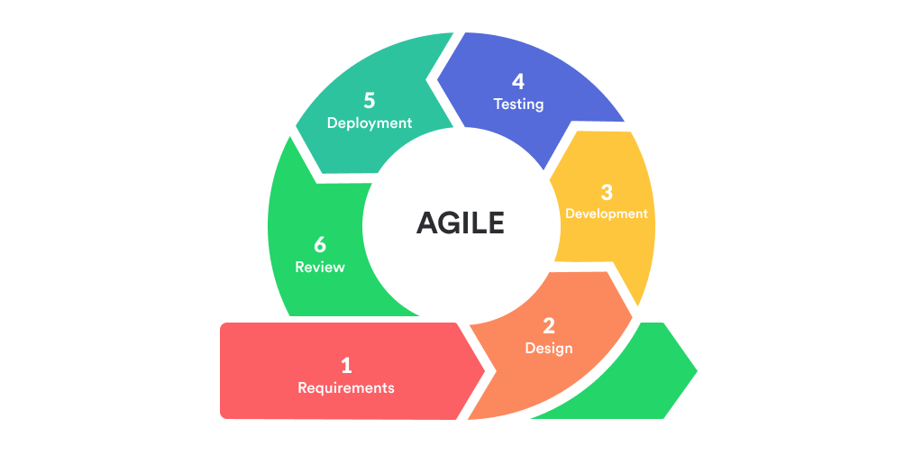
METHODOLOGY

Slide 12
IMPLEMENTATION
The proposed automated hostel reservation system will be a web-based program, and there are steps that will be taken in order to achieve a solution to the above, which are as follows:
Phase 1: Requirements
At this phase I will gather and document the system’s needs. I will conduct stakeholder interviews with hostel staff, potential users, and any other relevant parties to gather requirements. I will document the plan, timing, and budget for completing the iterations. I will create user stories, detailing the functionality and features needed for the hostel reservation system. At this stage the requirement document is created, containing both functional requirements (such as user interface and homepage) and non-functional requirements (such as the security) of the system.
Phase 2: System Design
Based on the prioritized user stories, I will create wireframes or mockups to visualize the user interface and user experience. I will also design the database schema for storing reservation data and other relevant information. The design document would be created in this stage

Slide 13
IMPLEMENTATION
Phase 3: Implementation
I will set up a Next.js project with Tailwind CSS for the frontend and integrate Firebase for backend services. I will also implement user authentication, allowing users to sign up, log in, and manage their profiles. I will develop the reservation system, including the ability to browse available hostels, view details, and make reservations. I will also implement real-time updates using Firebase to reflect changes instantly to all users.
Phase 4: Testing
I will conduct unit testing to ensure individual components work as expected. I will perform integration testing to validate the interaction between different parts of the system and conduct User Acceptance Testing (UAT) with stakeholders and potential users to gather feedback. This is the stage in which our implemented application is tested to ensure that it is fully functional and meets all standards, allowing people to utilize the platform without inconvenience.
Phase 5: Deployment
The hostel reservation software reaches the deployment phase when it has been thoroughly tested and all essential iterations have been completed. I will deploy the system to a production environment, making it accessible to users.

Slide 14
CONCLUSION
Upon completion of the project, the anticipated outcomes are as follows:
Delivery of a robust and user-friendly online platform with an intuitive and comprehensive user interface, enhancing the overall user experience.
Implementation of a secure user authentication system, enabling users to log in and seamlessly browse available hostels while making reservations through an efficient reservation system.
Successful establishment of a fully functional web-based application that integrates Next.js for the frontend and Firebase for the backend, ensuring real-time updates and scalability.
Significant improvement in the efficiency of handling hostel reservations, offering a streamlined process for users to make bookings, and enhancing overall business productivity and income.
The proposed approach is poised to revolutionize how the hostel manages reservations, providing an elevated level of customer satisfaction through an improved and efficient online reservation system. This not only enhances the overall customer experience but also contributes to increased business productivity and revenue.

